Slide 1
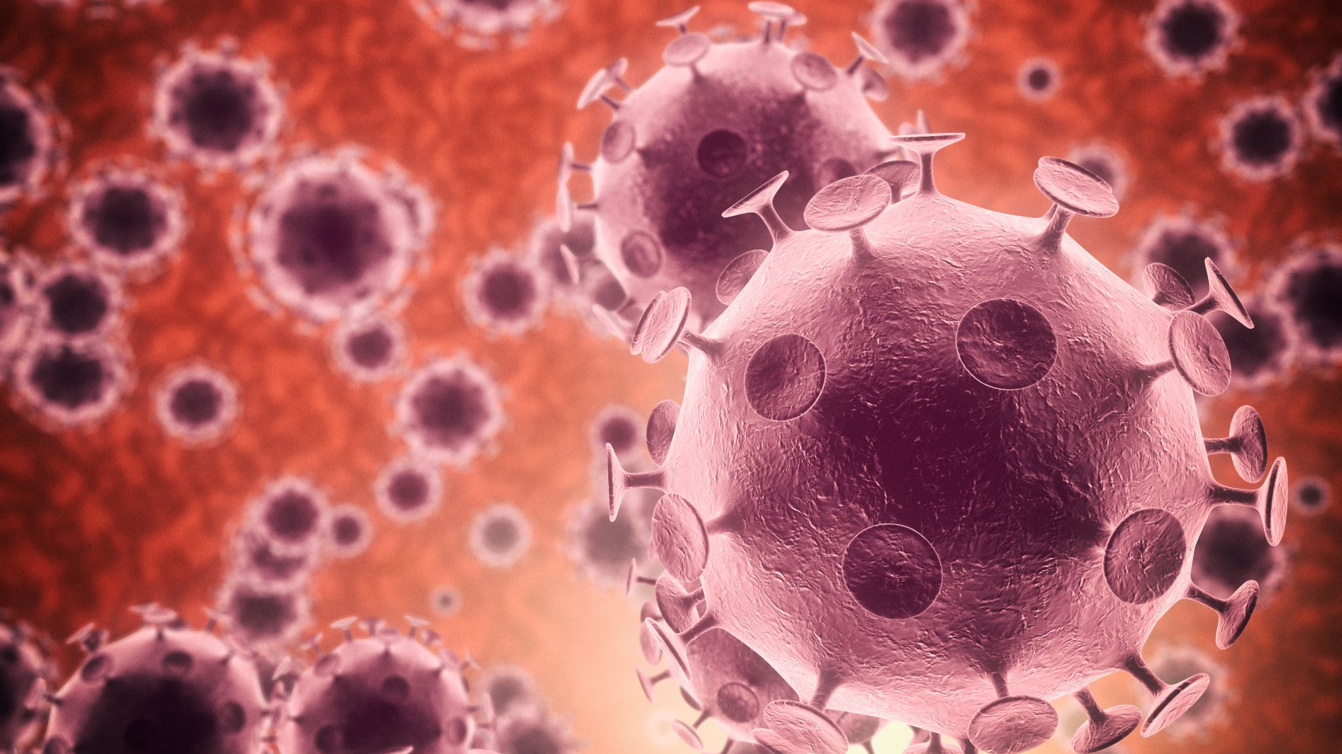
Influenza Updated by Ms Rayner 2022

Slide 2
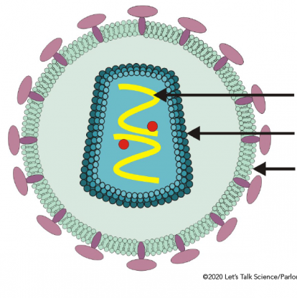
Influenza Virus
The infectious agents that cause influenza are the influenza A, B or C viruses.

Slide 3
Influenza Virus Structure
The single-stranded enveloped RNA virus

Slide 4
Influenza Life Cycle
Infected host reservoir
Site for replication of infectious agent – Epithelial cells of the Respiratory System
Portal of exit via cough & sneeze releasing influenza virus in airborne droplets
Mode of transmission
1. Air borne droplets (direct transmission via close contact)
2. Direct contact via touch
3. indirect contact via fomites & airborne droplets that have become aerosols
Portal of entry via inhaling airborne droplets containing influenza virus
Susceptible host
Caused by Influenza A, B or C Virus

Slide 5
Influenza life cycle

Slide 6
Influenza Virus Mode of Transmission
The influenza virus is usually transmitted from the respiratory tract, through the air inside airborne droplets, when an infected host coughs or sneezes.
The viruses, found in the airborne droplets/spray, are inhaled by a susceptible host in close proximity
Therefore, the mode of transmission is primarily direct transmission via close contact

Slide 7
Influenza Virus Mode of transmission
After the release of new viruses from the epithelial cells, a cough or sneeze may send a spray of airborne droplets into the air.
The droplets may be inhaled by someone in close proximity or become an aerosol and drift with air currents, to be inhaled at a later time or land on a surface known as a fomite.
Therefore, transmission, although usually direct via close contact, can be indirect via airborne droplets or fomites.

Slide 8
Influenza Modes of Transmission
Direct transmission
Direct contact
Transmission due to physical touch between an infected host and a susceptible host via body fluids on hands after cough or sneeze
Close contact
Transmission of pathogen in airborne droplets between an infected host and a susceptible host, such as sneezing/coughing within 1 metre or due to close proximity

Slide 9
Influenza Modes of Transmission
Indirect transmission
Airborne droplets
When the airborne droplets (if small enough) become an aerosol & drift with the air currents beyond 1 – 2 meters, to be inhaled at a later time by a susceptible host
Fomite
When airborne droplets containing influenza virus land on an inanimate object making it a fomite

Slide 10
Influenza Virus Mode of transmission
Mode of transmission – Close contact
Spread by close host contact, airborne droplets and touching contaminated surfaces
How quickly the virus spreads via these methods will be influenced by
Host density
Host behaviour
Spread will be faster when host density is high because potential hosts come in close contact more often
Spread will be faster if hosts have unhygienic practices
Will spread to new areas if infected hosts move around

Slide 11
Influenza Virus Replication
The viruses will attach to epithelial cells along the respiratory tract
If those cells contain suitable virus receptor cells.
The influenza virus is an RNA-type virus. It will undergo viral replication inside the epithelial cells.
After the release of new viruses from the epithelial cells, a cough or sneeze may send a spray of airborne droplets into the air.

Slide 12
Influenza – Prevention
Vaccination
Hygiene
Washing hands
Using hand sanitizer
Cover cough & sneezes
Cleaning & sanitizing surfaces
Quarantine
Isolate when sick while exhibiting symptoms of illness
Stay away from work, child care, school, mass gatherings
Personal PPE
Face masks

Slide 13
Influenza – Treatment
Rest
Drink fluids
Paracetamol
Decongestants
Antivirals
Hospitalization

Slide 14
Watch!
https://www.youtube.com/watch?v=WSZEcpti2i0&list=PLsMs3sjjy-pCcR8l3ohnIUhIiCwEjQB6K&index=93
https://www.youtube.com/watch?v=oXzwtGFyBik

